Slide 1

2023-24 3-1 Alternative stable states, phase shifts and catastrophic transitions. Chaos and unpredictability Phase Shifts and Catastrophic Transitions
Vincent Jansen
vincent.jansen@rhul.ac.uk

Slide 2
Outline
3-1 Alternative Stable States , Phase Shifts and Catastrophic Transitions
3-2 Chaos and unpredictability

Slide 3
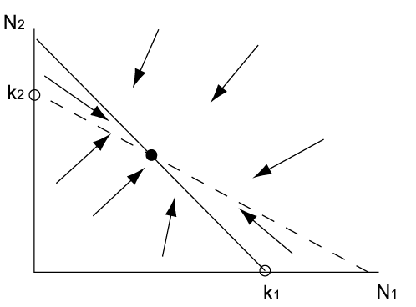
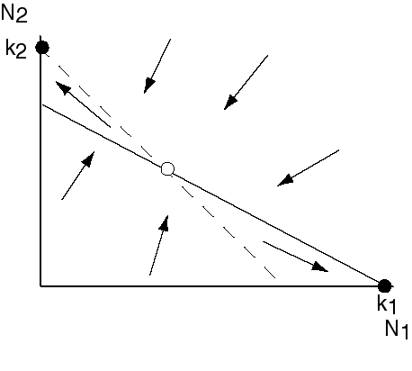
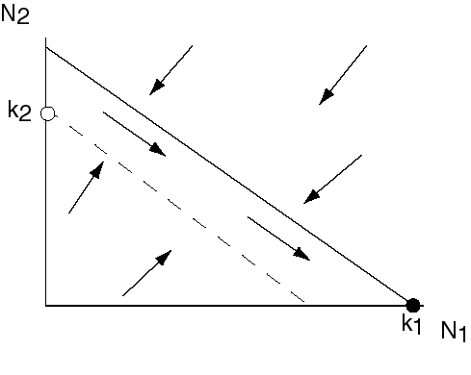
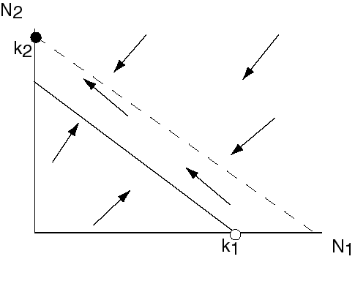
Dynamics of LV model and classification as bifurcations
α
k₁/k₂
k₁/k₂
1/β

Slide 4
Dynamics of LV model and classification as bifurcations
Transitions happen when
1/β=k₁/k₂
α=k₁/k₂
Or, written differently, when
k₂=k₁/α
k₂=k₁β

Slide 5
Bifurcations in the LV model
Codim 2 Bifurcation diagram of LV competition model
k₂
k₂=k₁/α
k₂=k₁β
k₁

Slide 6
What happens if we change the carrying capacity?
k₁/α
k₁/α
k₁/α
k₁
k₁
k₁

Slide 7
Phase shift
N₂ only
N₁ and N₂
N₁ only
N₂
k₂α
k₂/β
k₁

Slide 8
Phase shift
N₂ only
N₁ and N₂
N₁ only
N₁
k₂α
k₂/β
k₁

Slide 9
Bifurcations in the LV model
Codim 2 Bifurcation diagram of LV competition model
k₂
k₂=k₁β
k₂=k₁/α
k₁

Slide 10
Other option if we change the carrying capacity (for different α and β)

Slide 11
Alternative Stable States, Catastrophic transition
N₂
N₁ or N₂
N₂
N₁
k₂/β
k₂α
k₁

Slide 12
Alternative Stable States, Catastrophic transition
N₁
N₁
N₁ or N₂
N₂
k₂/β
k₂α
k₁

Slide 13
Codim 2 Bifurcation diagram of LV competition model
k₁
N₂*
k₂
k₂=k₁β
k₂=k₁/α
k_{1/}/α
k₁β
k₁
k₂
k₁

Slide 14
Generic situation
Bifurcation diagram of the metapopulation with rescue effect
p
Eigenvalue is 0 at this point
m
A fold bifurcation (also called saddle-node)

Slide 15
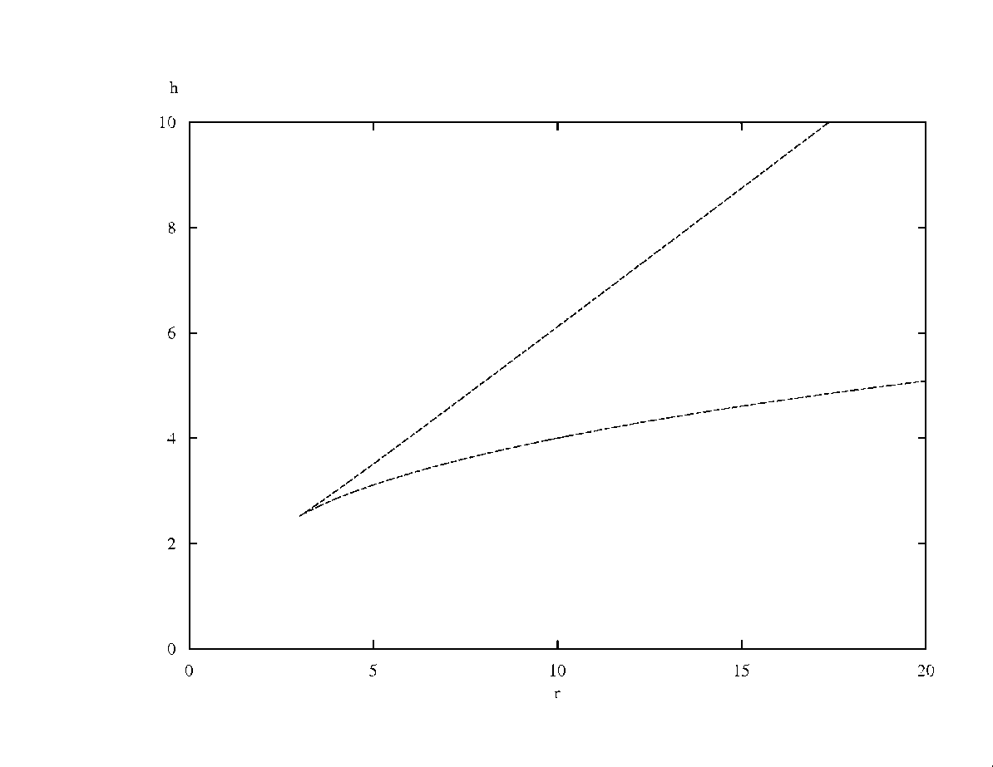
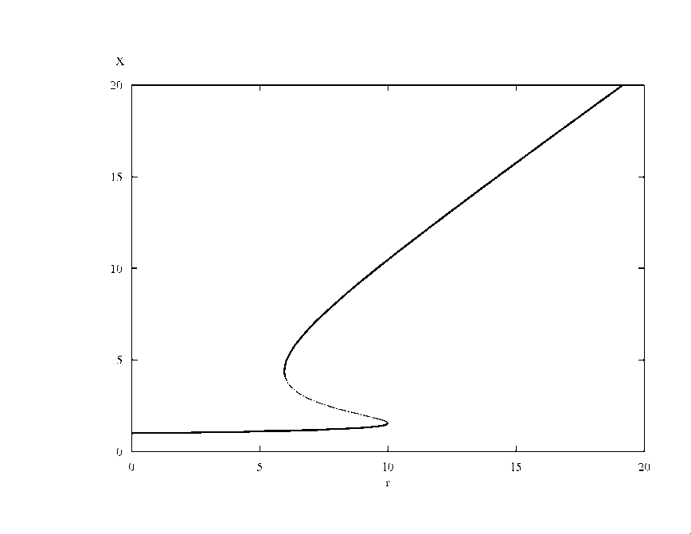
Generic situation
Generic codim 2 Bifurcation diagram
This is a cusp bifurcation
h
x
r
r

Slide 16
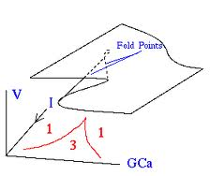
Generic situation
Generic codim 2 Bifurcation diagram
This is cusp bifurcation
h
x
r
r

Slide 17
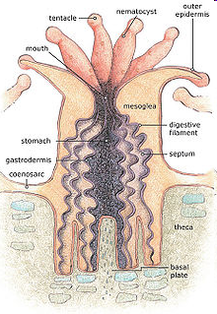
Coral Reefs
Coral reefs are made out of colonies of “polyps”. Reef building corals belong to the phylum Cnidaria
Occur in nutrient poor waters
They have tentacles to capture prey
Polyps secrete calcium carbonate, that accumulate and forms the reef
Reproduction mainly asexual through budding
Notes:
Cnidaria (jellyfish, anemones, hydroids).

Slide 18
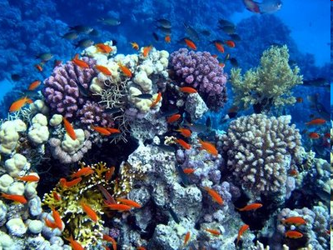
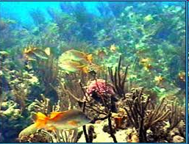
Coral Reefs
Coral reefs are highly diverse both in terms of corals as in other marine animals

Slide 19
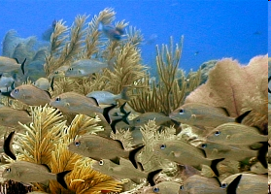
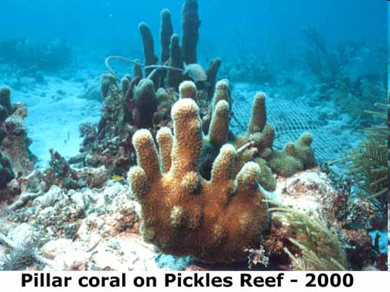
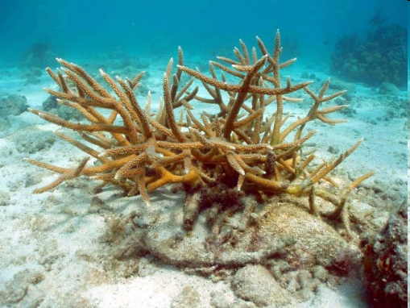
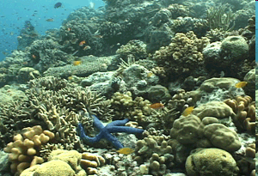
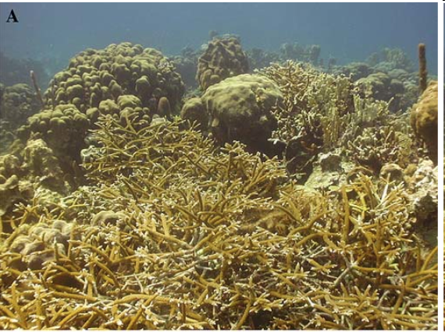
Notes:
Stag horn (bottom lef) pillar coral (top right)

Slide 20
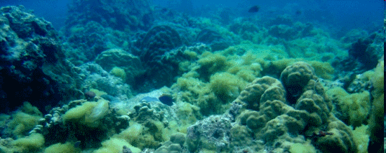
Coral Reefs
Corals compete for space with algae and macroalgae
If space opens up all players will try to fill it
Macroalgae can overgrow a coral, coral can invade algal turfs

Slide 21
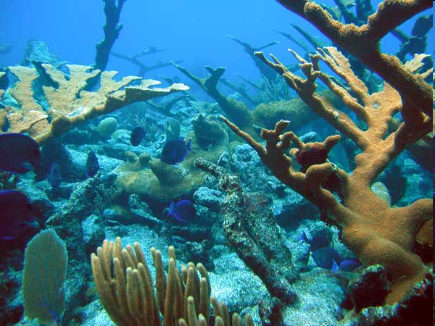
Blue tangs swimming in an elkhorn coral forest

Slide 22
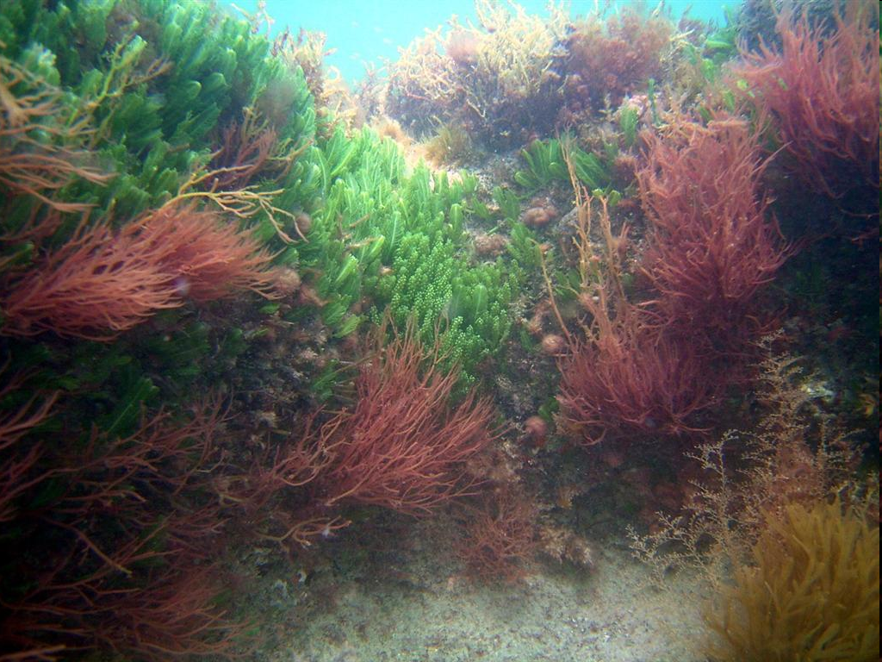
Coral overgrown with macroalgae

Slide 23
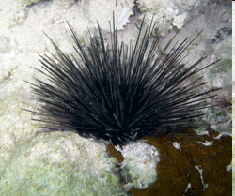
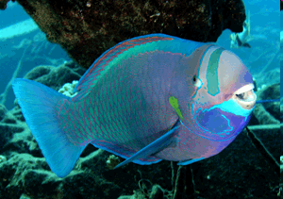
Coral reefs
Even though algae can overgrow coral, this normally is prevented through herbivores, who feed on the macroalgae
Diadema antillarum
(long spined sea urchin)
Parrot fish

Slide 24
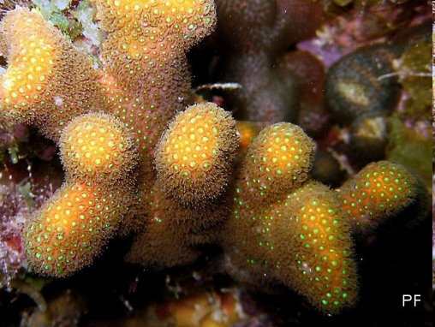
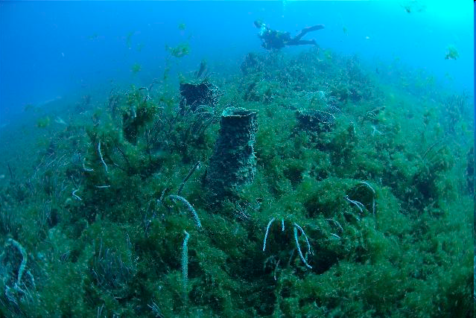
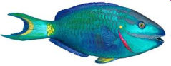
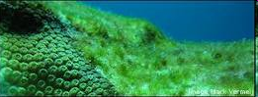
Simplified Coral Reef Ecology
Overgrowing
macroalgae
coral
Vegetative
spread
Colonisation dead coral
Overgrowing
Grazing
algal turf
herbivores

Slide 25
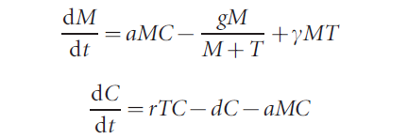
The same information, put in a model
with T+M+C=1
M, C and T describe the amount of space covered by Macroalgae, algal Turf and Coral
From: Mumby et al. Nature (2007)

Slide 26
Isoclines for the coral reef model
C
M
In the model, changing the amount of grazing, which determines the death rate of the macroalgae, is much the same as reducing the carrying capacity of the macroalgae.

Slide 27
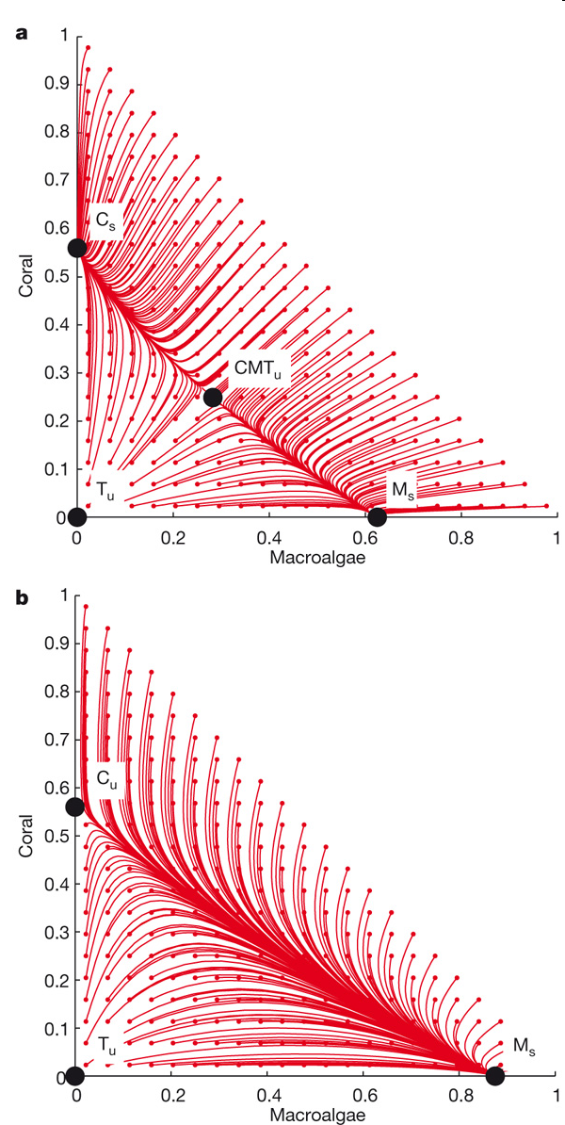

Slide 29
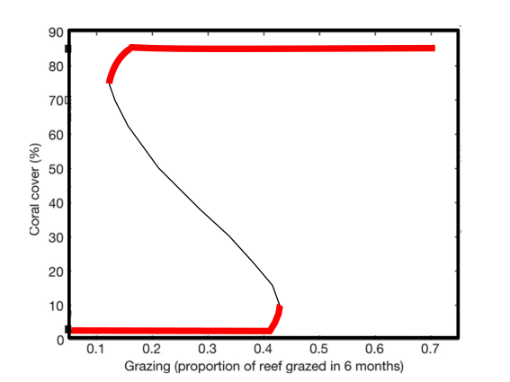
Bifurcation diagram for the Mumby model

Slide 30
Carribbean Coral Reefs
In the early 1980’s Caribbean reefs experienced a sudden shift from coral dominated reefs to reefs with substantial macroalgae populations
This followed a time of chronic fishing of herbivores, hurricane damage and a die-off of Diadema antillarum in 1983

Slide 31
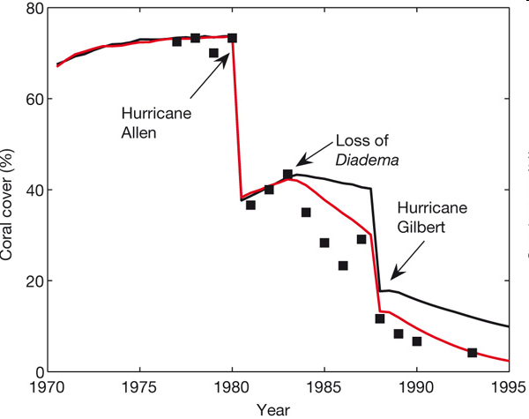
Coral cover in Jamaican reefs
Predictions are denoted by lines and empirical data are denoted by black squares
Notes:
Predictions are denoted by lines and empirical data are denoted by black squares. The model that was run with a median algal–coral overgrowth rate of 8 cm2 yr-1 is shown with a black line and the upper rate of 14 cm2 yr-1 is shown with a red line. 1983 Massive disease induced mortality in the sea urchins

Slide 32
Data explained using alternative stable states
Notes:
Stable and unstable equilibria are denoted by solid and open squares, respectively. Black denotes 8 cm2 yr-1, red denotes 14 cm2 yr-1. Blue lines, marked with appropriate dates, represent model predictions of the trajectory of reefs in Jamaica (see also Fig. 1).

Slide 33
Data explained using alternative stable states
Grazing Carrying capacity k₁
Notes:
Stable and unstable equilibria are denoted by solid and open squares, respectively. Black denotes 8 cm2 yr-1, red denotes 14 cm2 yr-1. Blue lines, marked with appropriate dates, represent model predictions of the trajectory of reefs in Jamaica (see also Fig. 1).

Slide 34
Alternative Stable States, Catastrophic transition
N₂
N₁ or N₂
N₂
N₁
k₂/β
k₂α
k₁

Slide 35
Data explained using alternative stable states
Notes:
Stable and unstable equilibria are denoted by solid and open squares, respectively. Black denotes 8 cm2 yr-1, red denotes 14 cm2 yr-1. Blue lines, marked with appropriate dates, represent model predictions of the trajectory of reefs in Jamaica (see also Fig. 1).

Slide 36
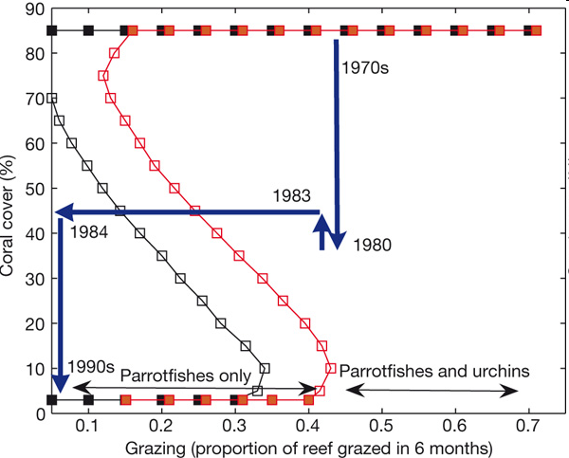
Data explained using alternative stable states
Notes:
Stable and unstable equilibria are denoted by solid and open squares, respectively. Black denotes 8 cm2 yr-1, red denotes 14 cm2 yr-1. Blue lines, marked with appropriate dates, represent model predictions of the trajectory of reefs in Jamaica (see also Fig. 1).

Slide 37
Coral cover in Jamaican reefs
Predictions are denoted by lines and empirical data are denoted by black squares
Notes:
Predictions are denoted by lines and empirical data are denoted by black squares. The model that was run with a median algal–coral overgrowth rate of 8 cm2 yr-1 is shown with a black line and the upper rate of 14 cm2 yr-1 is shown with a red line. 1983 Massive disease induced mortality in the sea urchins

Slide 38
Coral reef recovery
Reef coverage declined following a time of chronic fishing of herbivores, hurricane damage and a die-off of Diadema antillarum in 1983
Although Diadema beginning to return in some places, reef recovery is patchy and many reefs still have not recovered to previous levels of coverage

Slide 39
Catastrophic transitions: management implications
If coral reefs, or other ecosystems have alternative stable states, this has important management implications.
In general, prevent large perturbations and manage so that the basin of attraction of the desirable state is largest
For instance, through limiting overfishing of herbivores

Slide 40
Evidence
Although a compelling story, it is not universally accepted that the decline of coral reefs is caused by alternative stable states.
One of the problems that it is hard to show in a real ecosystem that there are multiple stable states
See See Mumby et al. Oikos (2013), also Dudgeon et al. MEPS (2011)

Slide 41
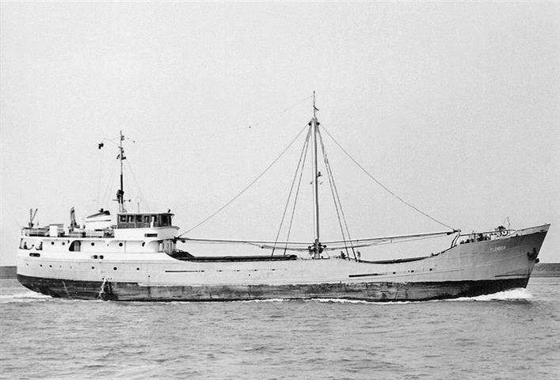
The wreck of the MV Florida
In June 1976 the MV Florida, on a voyage to Townsville, Queensland, carrying a cargo of pozzalin, ran ashore at Myrmidon Reef. The ship broke in two and spilled its cargo

Slide 42
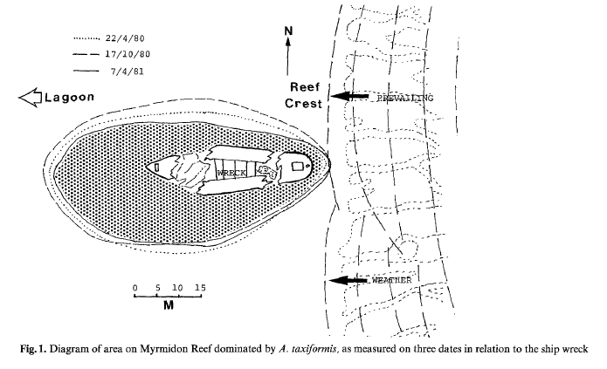
The pozzalin washed away. But five years later macroalgae still dominated the area where the cargo had been spilled.
Evidence or anecdote?
Macroalgae dominated
Coral dominated
From: Hatcher Coral Reefs 3, 4 (1984): 199-204.

Slide 43
Evidence
In general, it is difficult to show this conclusively, as:
Catastrophic shifts are rare events
Statistic methodology underdeveloped
To demonstrate alternative stable states one needs:
1. Repeated shifts
2. To show it is plausible that there are alternative stable states (fit data using models)

Slide 44
1. Repeated shifts: A spatial regime shift in a large coastal ecosystem
Swedish marine bays can be dominated by large predatory fish (perch, pike) or the three-spined stickleback.
>13,000 surveys in 486 shallow bays during 1979–2017 show a shift in dominance that gradually spread.
In this case the observation was repeatedly made in many lakes.
Eklöf, et al. A spatial regime shift from predator to prey dominance in a large coastal ecosystem. Commun Biol 3, 459 (2020). https://doi.org/10.1038/s42003-020-01180-0

Slide 45
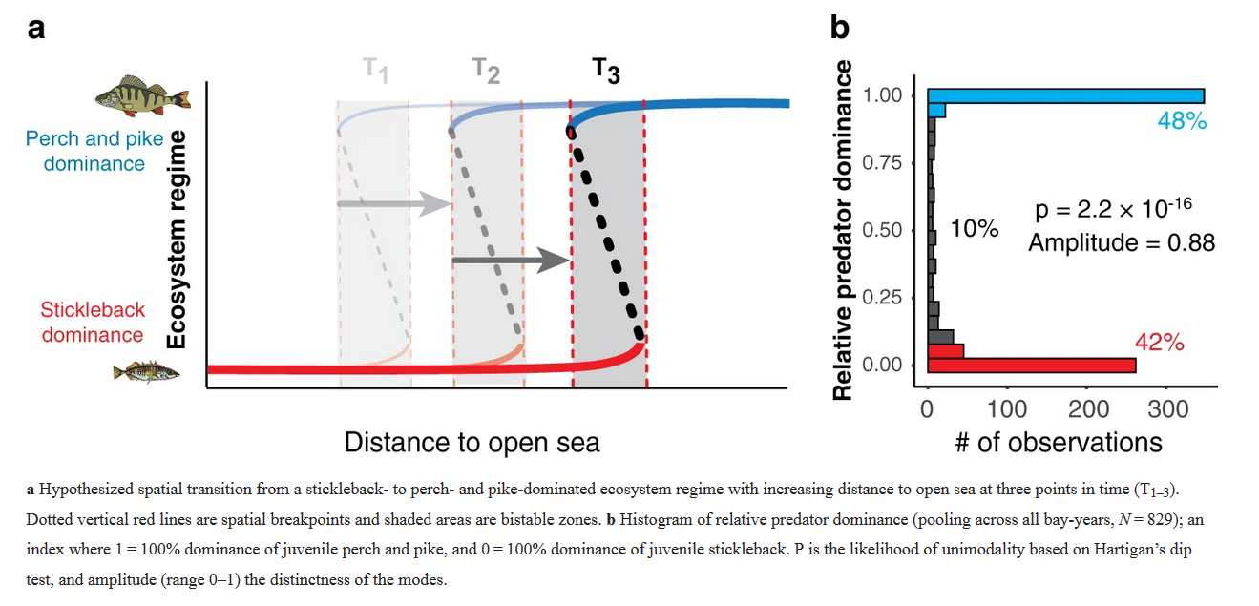
A spatial regime shift in a large coastal ecosystem

Slide 46
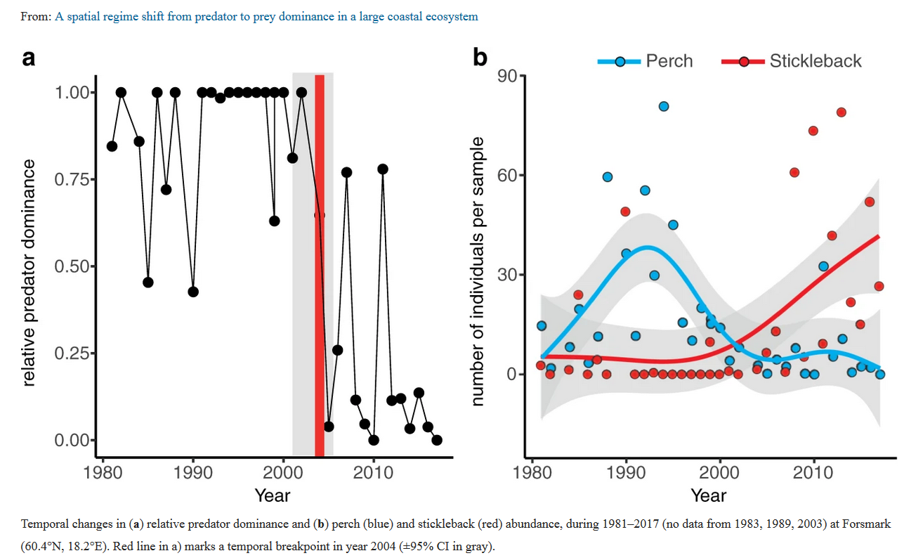
A spatial regime shift in a large coastal ecosystem

Slide 47
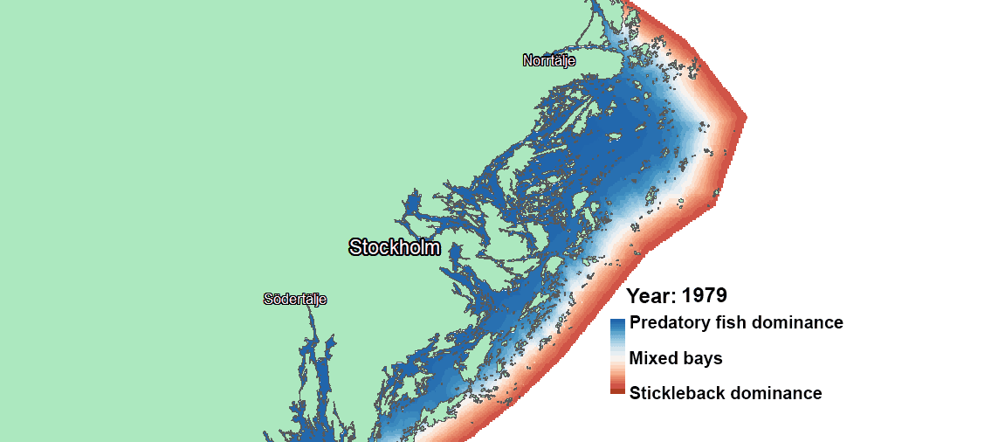
A spatial regime shift in a large coastal ecosystem
The stickleback wave' sweeping across the greater Stockholm archipelago (SW Baltic Sea) during 39 years (1979-2017).
Notes:
https://natureecoevocommunity.nature.com/posts/the-stickleback-wave-a-spatial-regime-shift

Slide 48
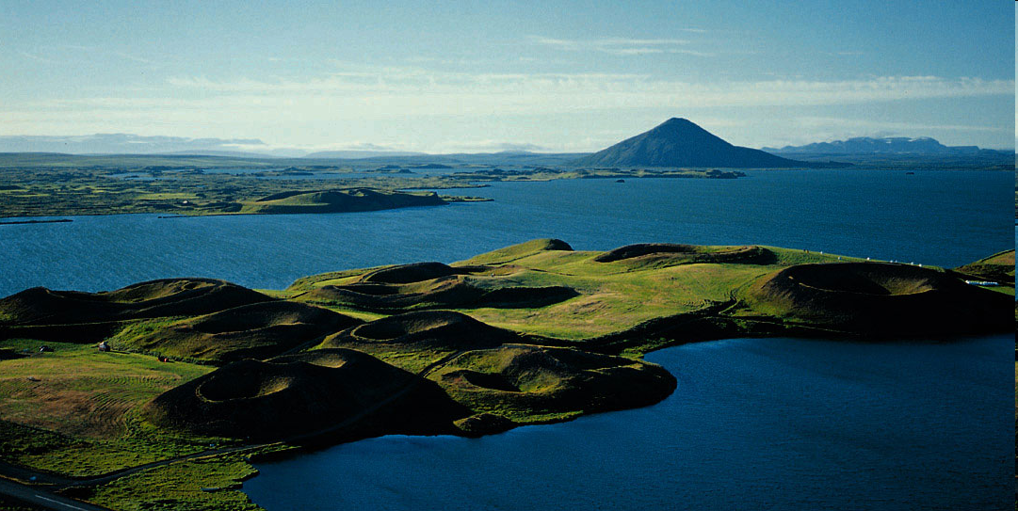
2. Model fitting to show alternative stable states are plausible
Lake Myvatn, Iceland

Slide 49
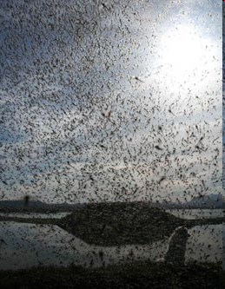
Midges can be highly abundant
Swarms ofTanytarsus gracilentus

Slide 50
From Ives et al. Nature 2008

Slide 51
Possible explanation: Alternative stable states

Slide 52
Demonstrating existence of alternative stable states
3 models are compared
Only the midge-algae detritus model has alternative stable states
This is best description given the data

Slide 53
Learning outcomes
Understand how a change in carrying capacity can bring about a qualitative change in the dynamics: a bifurcation
Understand how a change in carrying capacity can bring about a qualitative change
the difference between a phase transition and catastrophic transition
Understand the importance of transitions for ecosystems, management and conservation

